Slide 2
What is safety and reliability engineering in relation with robotics and automation system?

Slide 3
Agenda
Safety engineering
System safety
Robot safety
Reliability engineering
Risk assessment

Slide 4

Safety engineering
Safety engineering is the application of basic scientific and technical principles to the mitigation or reduction of loss of life, property, and the environment by recognized hazards(potential source of harm). It requires a broad knowledge of mathematics, chemistry, physics, and other basic sciences and a familiarity with one or more of the recognized branches of engineering.
The ultimate goal of all efforts in safety engineering should be to reduce accidents and harmful exposures.

Slide 5
System safety
System safety is an engineering discipline, according to MIL_STD_882E defines system safety as “ the application of engineering and management principles, criteria, and techniques to achieve acceptable risk, within the constraints of operational effectiveness and suitability, time, and cost, throughout all phases of the system life cycle”.
Notes:
MIL-STD-882E, DEPARTMENT OF DEFENSE STANDARD PRACTICE: SYSTEM SAFETY (11-MAY-2012). https://reliabilityanalytics.com/reliability_engineering_library/MIL-STD-882E_Department_of_Defense_Standard_Practice_System_Safety_11_May_2012/MIL-STD-882E_Department_of_Defense_Standard_Practice_System_Safety_11_May_2012_pp_14.htm
Asimov’s ”Three Laws of Robotics” (Asimov), a robot must not injure a human being, should work reliably, and must not damage itself.

Slide 6
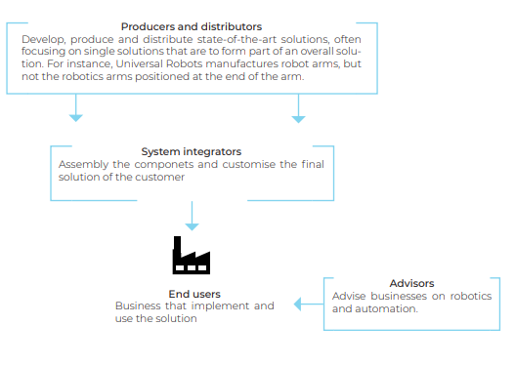
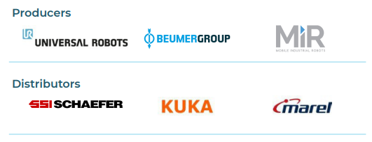
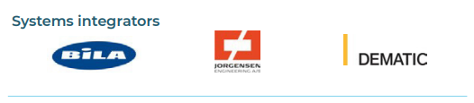

The robotics and automation industry

Slide 7
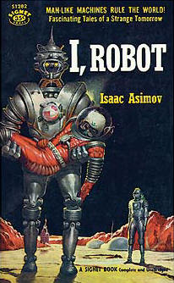
Robot safety
The Three Laws, presented to be from the fictional "Handbook of Robotics, 56th Edition, 2058 A.D.", are:
The First Law: A robot may not injure a human being or, through inaction, allow a human being to come to harm.
The Second Law: A robot must obey the orders given it by human beings except where such orders would conflict with the First Law.
The Third Law: A robot must protect its own existence as long as such protection does not conflict with the First or Second Law.

Slide 8
Evolution of Laws: Robotics, Nanorobotics, and AI
Asimov’s Three Laws of Robotics (1942) 1. A robot may not harm a human. 2. Must obey human orders (unless conflicts with 1). 3. Must protect its own existence (unless conflicts with 1 or 2). Context: Science fiction ethics. Risks: Harm to humans, obedience, self-preservation.
Sailor’s Three Laws of Nanorobotics (2012) 1. Nanorobots must be killable (fail-safe). 2. Must be controllable (external oversight). 3. Must be limited in reproduction. Context: Practical nanotechnology safety. Risks: Uncontrolled replication, loss of control, shutdown failure.
Russell’s Principles for Safer AI (2017) 1. AI’s only objective is to maximize human values. 2. AI must be uncertain about those values. 3. AI must be open to correction. Context: Real-world AI alignment. Risks: Misaligned goals, unintended consequences, uncorrectable systems.
Notes:
Facilitator leads the group into the big-picture insight:Technology evolves → so do our “laws.”Early frameworks (Asimov) → mostly about morality.Later ones (Sailor, Russell) → integrate engineering limits, uncertainty, adaptability.Ask: “What might the next generation of laws look like?”
Possible threads:Should laws be universal, or domain-specific?Should they be hard-coded, or adaptable/self-updating?What role should governments, companies, and communities play in shaping them?

Slide 9

Robot safety
Notes:
Robots are introduced in the operating systems and processes to substitute for humans and replicate human actions in situations for many purposes, but today many are used in hazardous environments.

Slide 10
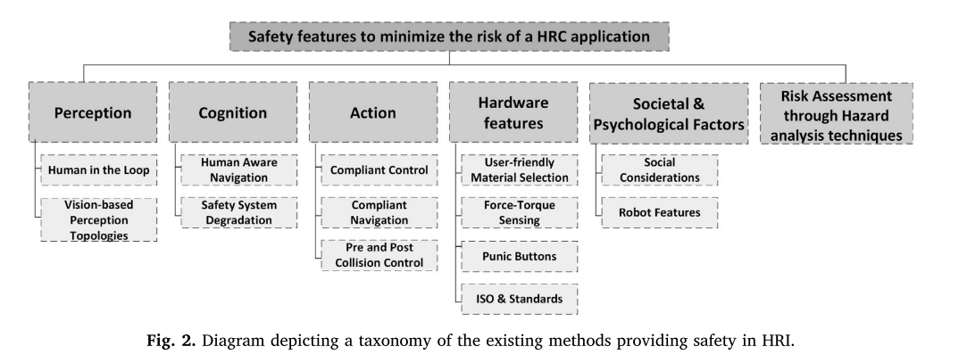
Robot safety
Many articles, directly or indirectly, in the 1970s and early 1980s covered the topic of robot safety: in 1985 and 1986, two standards titled” An Interpretations of the Technical Guidance on Safety Standards in the Use, etc. of Industrial Robots” and” Industrial Robots and Robot Systems-Safety Requirements” were published by the Japanese Industrial Safety and Health Association and the American National Standards Institute, respectively.
Zacharaki, A., Kostavelis, I., Gasteratos, A., & Dokas, I. (2020). Safety bounds in human robot interaction: A survey. In Safety Science (Vol. 127). Elsevier B.V. https://doi.org/10.1016/j.ssci.2020.104667

Slide 11
Reliability and Reliability Engineering
The history of the field of reliability goes back to the early years of the 1930s, when probability concepts were applied to problems in the area of electric power generation. However, the real beginning of the filed is normally regarded as World War II, When German scientists applied basic reliability concepts for improving the reliability of their V1 and V2 rockets.
Some definitions of Reliability in the past include:
-Reduction of things gone wrong.
-An attribute of a product that describes whether the product does what the user wants it to do, when the user wants it to do so.
-The capability of a product to meet customer expectations of product performance over time.
-The probability that a device, product, or system will not fail for a given period of time under specified operating conditions.
-ISO 12100:ability of a machine or its components or equipment to perform a required function under specified conditions and for a given period of time without failing.

Slide 12
Reliability and Reliability Engineering
Conceptual hierarchy for improving performance from Reliability Engineering and Risk Analysis: A practical Guide
Modarres, M., Kaminskiy, M.P., & Krivtsov, V. (2016). Reliability Engineering and Risk Analysis: A Practical Guide, Third Edition (3rd ed.). CRC Press. https://doi.org/10.1201/9781315382425

Slide 13
Why Do Risk Management?
Purpose of risk management
Balancing benefits vs. risks
Risk‑based decision making

Slide 14
Business Reasons – Cost Efficiency
Identify safety‑critical design areas early
Avoid over‑engineering
Correct flaws early to reduce cost

Slide 15
Avoiding Recalls & Corrective Actions
Recalls are costly and damage reputation
Risk management prevents adverse events
Ability to forecast serious risks

Slide 16
Improved Communication
Breaks down silos
Cross‑disciplinary collaboration
Clearer understanding of risks

Slide 17
Moral & Ethical Reasons
Patient trust
Duty to deliver safe devices
Ethical responsibility of manufacturers

Slide 18
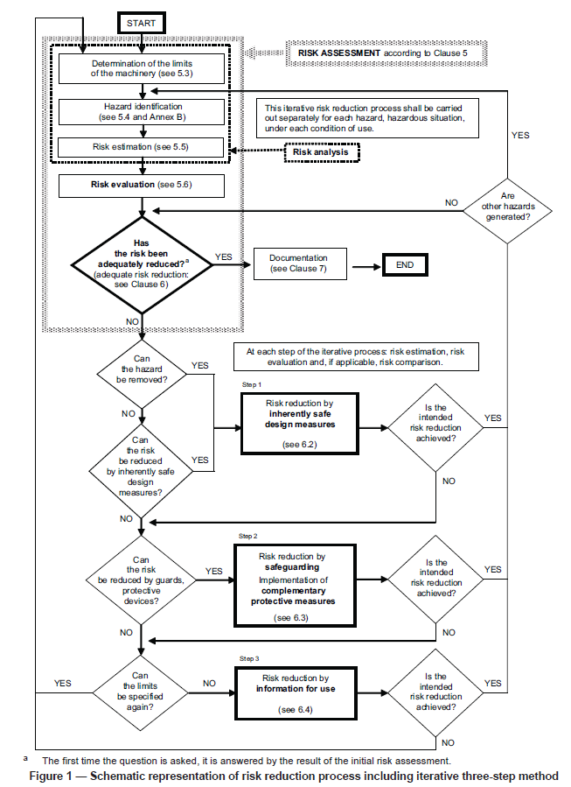
Risk assessment
Risk Assessment: overall process comprising a risk analysis and a risk evaluation.
Risk analysis: combination of the specification of the limits of the machine, hazard identification and risk estimation.
Risk evaluation: judgment, on the basis of risk analysis, of whether the risk reduction objectives have been achieved.

Slide 19
Basics of Risk Management
Importance of shared vocabulary
Risk management terminology
Avoiding miscommunication

Slide 20
Key Terms (1)
Basic Safety: Freedom from unacceptable risk from physical hazards
Essential Performance: Clinical functions requiring safety
Expected Service Life
Failure vs Fault

Slide 21
Key Terms (2)
Harm: Injury or damage
Hazard: Potential source of harm
Hazardous Situation: Exposure to hazards
Intended Purpose vs Intended Use

Slide 22
Risk Concepts
Risk = Probability + Severity
Risk Analysis vs Hazard Analysis
Residual Risk

Slide 23
Reasonably Foreseeable Misuse
Definition and misunderstandings
Intentional vs unintentional misuse
Six criteria for foreseeable misuse

Slide 24
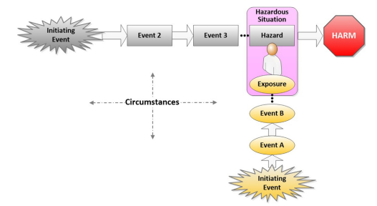
Hazard Theory
Initiating events
Hazard creation
Exposure creating hazardous situations
Severity factors

Slide 25
System Types
Integral Systems: Single-piece systems
Distributed Systems: Multiple components requiring integration

Slide 26
Safety requirements

Slide 27
Objectives
Understand the role of a) directives b) regulations and c) standards.
Understand the CE marketing process.
Understand the actions and stakeholders required to enforce regulation.

Slide 28


Guest lecture-Summary
Title: Standards, the machinery directive and CE marking
Guest lecturers
Pernille Arendsdorf Bengtsen
Konsulent | Consultant
Afdeling for international politik og kursus
Dansk Standard

Slide 29
What to expect: week 2

Slide 30
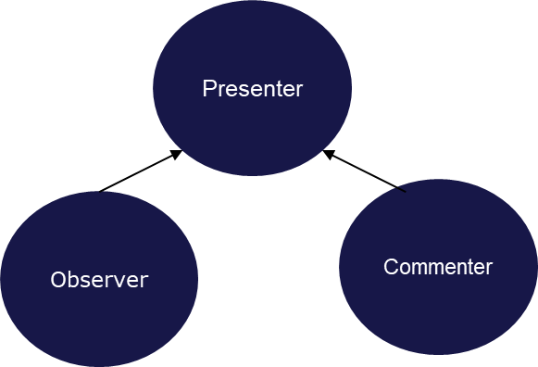
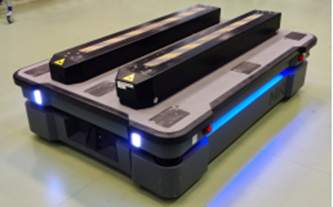
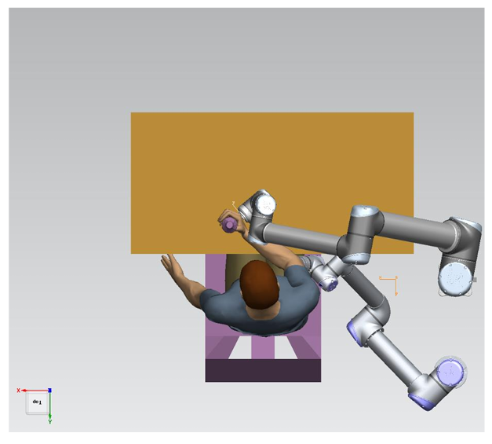
Grouping
Each group is composed of 4 persons. Each group selects one robot.
MiR 500
(Manufacturing)
Fort RD 25
(Agriculture)
Reharob 3.0
(Healthcare)
Pick and place
(Slaughter house)
Notes:
IEC 60601-1, ISO 14971

Slide 31
Exercise
Each group answers the following 3 questions in 8-10 minutes presentation :
What EU directives do you identify for the robot?
What standards do you identify for the robot, and why do you think they are relevant for the robot?
Identify hazards for the robot and use standards from Groups A, B, and C under machinery directive (choose at least one standard from each group) to illustrate how the standards can help with reduce risks associated with the identified hazard.

Slide 32
PRESENTER ROLE
Each group must clearly answer all three questions. Presentation Structure (8–10 minutes)

Slide 33
OBSERVER ROLE
Observers listen, evaluate, and prepare feedback.
During the Presentation
Observers should check and take notes on:
☐ Are all 3 questions answered? ☐ Are EU directives relevant and justified? ☐ Are standards clearly explained, not just listed? ☐ Is at least one hazard clearly identified? ☐ Are Group A, B, and C standards used? ☐ Is the link between hazard and risk reduction clear?
After the Presentation
Observers prepare:
One strength of the presentation
One unclear or missing point
One improvement suggestion
📌 Observers do not ask questions.

Slide 34
COMMENTER ROLE
Commenters engage actively with the presenters.
After the Presentation
Commenters must:
Ask 1–2 focused questions
Add one constructive comment
⚠️ Be respectful, concise, and technical.

